Slide 1
DNA
Year 11 Human Biology
ATAR
PowerPoint #14

Slide 2
SCSA Syllabus Reference
DNA occurs bound to proteins in chromosomes in the nucleus and as unbound DNA in the mitochondria.
DNA stores the information for the production of proteins that determines the structure and function of cells
the structural properties of the helical DNA molecule, including double-stranded, nucleotide composition and weak bonds involved in base pairing between the complementary strands, allow for its replication
protein synthesis involves the transcription of a gene on DNA into messenger ribonucleic acid (RNA) in the nucleus, and translation into an amino acid sequence at the ribosome with the aid of transfer RNA
Epigenetics is the study of phenotypic expression of genes, which depends on the factors controlling transcription and translation during protein synthesis, the products of other genes, and the environment

Slide 3
Lesson Intention
To explore the structure of DNA
To explore the structure of chromosomes
To explore the structure of mitochondrial DNA
To explore the processes of DNA replication and protein synthesis
To explore the process of protein synthesis
To explore the process of gene expression, lipid and carbohydrate synthesis
To explore the concept of epigenetics

Slide 4
Success Criteria
identify the components in the structure of DNA
describe the structure of DNA
construct DNA molecules following base pairing rules
describe the structure of chromosomes
describe the structure of mitochondrial DNA
describe the role of mitochondrial DNA
explain the stages of DNA replication
describe the structure of RNA
identify the different types of RNA and state their role in protein synthesis

Slide 5
Success Criteria
explain the process of DNA becoming proteins
explain the process of transcription
explain the process of translation
describe the process of gene expression
describe the process of lipid synthesis
describe the process of carbohydrate synthesis

Slide 6
Success Criteria
recall the different types of nucleic acids
describe the concept of epigenetics
explain the relationship between the environment and the epigenome

Slide 7
Vocabulary
DNA: a molecule in the nucleus of a cell that determines the types of proteins a cell can make.
Nuclear DNA: DNA found in the nucleus.
Nucleotide: units of phosphate, sugar and nitrogen base that make up the DNA molecule.

Slide 8
Vocabulary
Mitochondrial DNA: DNA found in the mitochondria
Chromosome: One of the 46 rod-like structures that appear in the nucleus of a human cell at the commencement of cell division
Histone: a special protein around which DNA is coiled to form chromatin

Slide 9
Vocabulary
Nucleosome: a length of DNA wound around eight histone proteins
Chromatin: a tangled network of DNA in the nucleus of a cell that is not dividing
Gene: section of a chromosome that contains the nucleotide sequence coding for a particular trait.

Slide 10
Vocabulary
DNA Replication: the production of an identical copy of DNA.
Helicase: the enzyme responsible for the separation of DNA strands during replication
DNA polymerase: Enzyme that joins nucleotides together
DNA ligase: Enzyme that joins short sections of DNA together

Slide 11
Vocabulary
Ribonucleic Acids: A special molecule that takes the code for amino acids from DNA to the ribosomes
Messenger RNA: An RNA molecule that transfers coded information from the nucleus to the ribosomes.
Ribosomal RNA: Nucleic acids that form part of the ribosomes.
Transfer RNA: An RNA molecule that brings amino acids from the cytoplasm to the ribosomes.

Slide 12
Vocabulary
Triplet: a sequence of three bases that is the code for a particular amino acid; also called a base triplet
Transcription: the process by which messenger RNA is formed, using the code in a DNA molecule by matching the sequence of nucleotides
RNA polymerase: an enzyme that is active during transcription of RNA from DNA

Slide 13
Vocabulary
Template strand: the strand of a DNA molecule that is used to form the sequence of bases in mRNA and is copied during transcription
Coding strand: the strand of a DNA molecule that is not used to form mRNA
Translation: the production of a protein using the information coded in the mRNA molecule; another name for protein synthesis.

Slide 14
Vocabulary
Codon: the strand of a DNA molecule that is not used to form mRNA
Anticodon: a sequence of three bases in a tRNA molecule that binds to a complementary sequence of three bases (the codon) in an mRNA molecule, to specify a particular amino acid during protein synthesis
Gene expression: the process where information in a gene is used to make a product

Slide 15
Vocabulary
Epigenetic: altering expression of a gene without changing the gene structure
Acetylation: addition an acetyl group to a histone protein so that gene expression is enhanced
Methylation: the addition of a methyl group to a DNA molecule that results in inhibition of gene expression
CpG sites: a site on a DNA molecule where a cytosine nucleotide is next to a guanine nucleotide; DNA methylation usually occurs at these sites

Slide 16
Structure of DNA
DNA (Deoxyribonucleic Acid) is one of the two main types of nucleic acids found in the body. The other is RNA, or ribonucleic acid.
In DNA, there are repeating units of nucleotides, each composed of a sugar molecule, a phosphate group and a nitrogenous base.
The four nitrogenous bases are adenine (A), thymine (T), guanine (G), and cytosine (C).

Slide 17
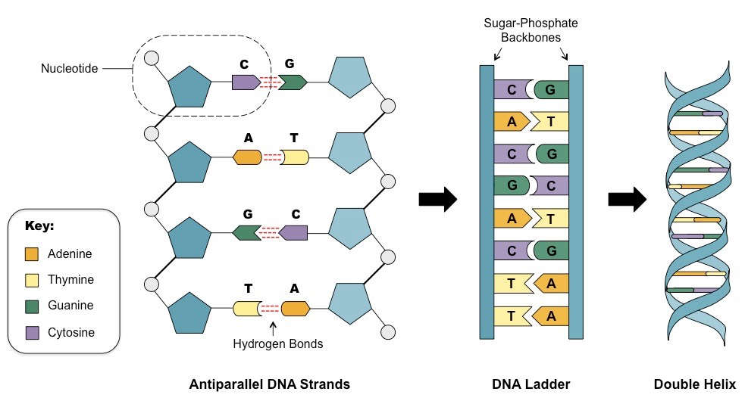
Structure of DNA continued
The sugar molecule of one nucleotide bonds to the phosphate group of another. Two strands join by weak hydrogen bonds in a double helix shape. The order in which the nitrogenous bases occur in the DNA molecule determines the genetic code.

Slide 18
Structure of chromosomes
The DNA strands are actually wrapped around a group of eight special proteins called histones to form a nucleosome. There are many nucleosomes along the length of a DNA molecule.
In a cell that is not dividing, the coiled DNA forms a tangled network called chromatin. However, when a cell divides the coiled chromatin becomes even more tightly coiled.

Slide 19
Structure of chromosomes
These super coiled structures are able to be seen under a microscope and are called chromosomes.
There are 46 chromosomes in a normal human cell. Each chromosome is made up of sections of DNA that code for a particular protein. Each of these sections is called a gene.

Slide 20
Mitochondrial DNA
Most of the cell’s DNA is located in the nucleus, but a small amount I in the mitochondria (mtDNA). It plays an important role in coding for transfer RNA and enzymes needed for cellular respiration.
There are 2 important differences between DNA in the nucleus and mtDNA.
Nuclear DNA is in the form of very long strands that are bound to proteins, the histones.
Mitochondrial DNA is in the form of small circular molecules that are not bound to proteins.

Slide 21
Replication of DNA
Cells divide by mitosis and meiosis.
In all cell divisions, the DNA must produce an exact copy of itself. This is known as DNA replication.

Slide 22
DNA Replication Stage One
The first stage of DNA replication is when the two stands of the DNA molecule are separated by the enzyme helicase. This separation is possible because the hydrogen bond between the base pairs is weak.
Each strand serves as a template for the nucleotides that will form the new strand. The new strand formed are identical to the original.
Two enzymes play important roles in the synthesis of the new strands. DNA polymerase adds the new nucleotides to the new strand, and DNA ligase joins short sections of DNA together.

Slide 23
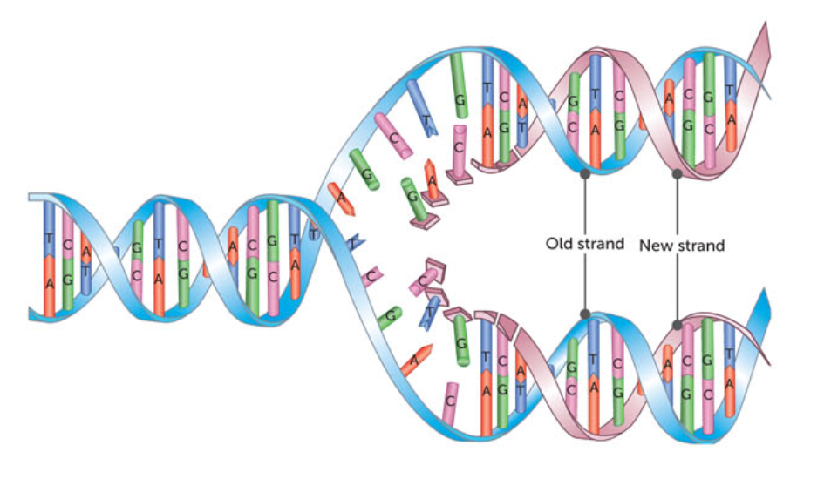

Slide 24
Protein Synthesis
The genetic code in DNA provides the instructions for protein synthesis- making proteins in the cell. Remember proteins are produced from amino acids being joined together by peptide bonds.
The sequence of bases in DNA controls the order of amino acids, and therefore the type of protein that is produced.

Slide 25
Revision- different types of proteins
Haemoglobin
Actin and Myosin
Fibrin
Collagen
Insulin
Amylase

Slide 26
RNA- Ribonucleic Acids
Another type of nucleic acid. Composed of a chain of nucleotides. While there are many similarities, there are key differences
The sugar molecule is ribose, not deoxyribose. Ribose has one more oxygen atom.
RNA is single stranded, while DNA is double stranded
RNA has the bases cytosine, guanine, adenine, uracil, while DNA has cytosine, guanine, adenine, thymine.
RNA is able to fold on to itself, forming hydrogen bonds between complimentary bases

Slide 27
Types of RNA
Messenger RNA (mRNA): is made in the nucleus and takes the genetic code into the cytoplasm allowing the genetic code to be ‘read’ by ribosomes
Ribosomal RNA (rRNA): makes up approximately 60% of the mass of ribosomes, with the other 40% being protein. The rRNA ensures the correct alignment of mRNA, tRNA and ribosome. It also has an enzymatic role in the formation of peptide bonds between amino acids.
Transfer RNA (tRNA): is a small molecule of RNA, containing only 70-90 nucleotides. Each tRNA molecule is able to carry a specific amino acid and therefore plays a vital role in protein synthesis.

Slide 28
From DNA to Proteins
DNA contains the genetic code, the sequences of bases determining the proteins that are produced.
A sequence of three bases is code for a particular amino acid and is called a triplet. E.g. the sequence CAG (cytosine-adenine-guanine) is a DNA code for the amino acid Valine.
With most DNA found in the nucleus being too large to leave, proteins are produced by ribosomes in the cytosol.

Slide 29
Transcription
Process by which the genetic instructions are copied from the DNA to the mRNA molecule.
Triggered by chemical messengers that enter the nucleus from the cytosol and bind to the DNA at the relevant gene. This causes an enzyme called RNA polymerase to begin the process of making mRNA.

Slide 30
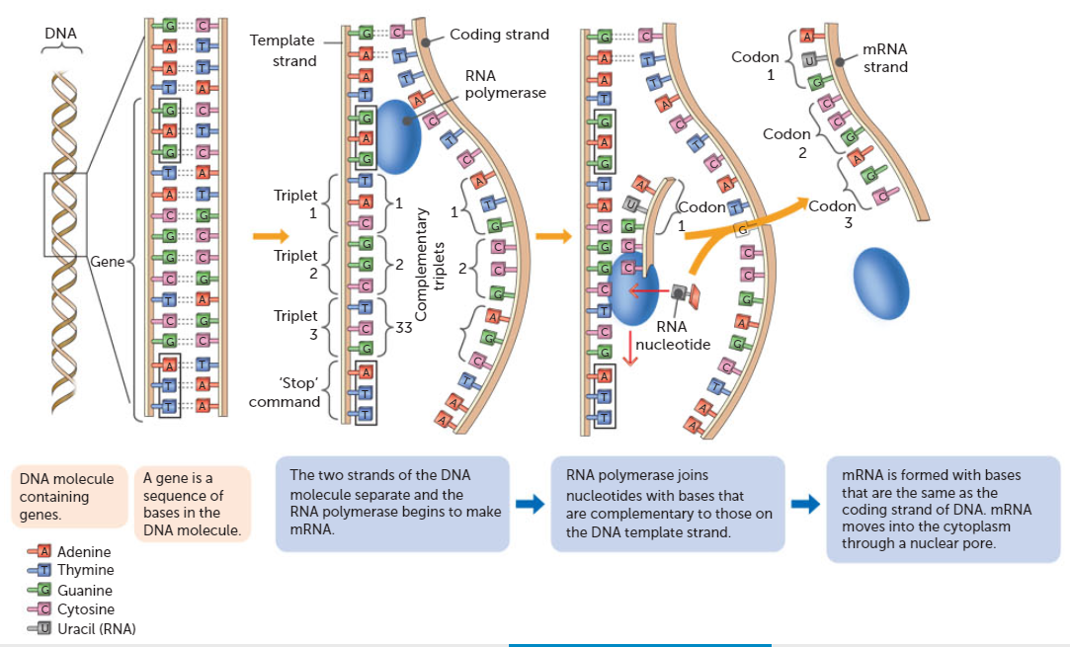

Slide 31
Translation
The production of a protein using the information that is coded in the mRNA molecule. In the cytosol, a ribosome attaches to one end of the mRNA molecule at a particular sequence of bases (adenine, uracil, guanine) called the start codon.
This ensures that the ribosome attaches to the correct end of the mRNA molecule. The ribosome then moves along the mRNA three bases at a time.

Slide 32
Translation
Each group of three bases is called a codon and corresponds to a specific amino acid. The start codon, AUG, also codes for the amino acid methionine. This means that every protein begins with methionine when it is first made. However, it may be removed later.
As the ribosome reads the codons on the mRNA, the tRNA molecules with the complementary bases join to the mRNA. The sequence of three bases matching the codon is called the anticodon.

Slide 33
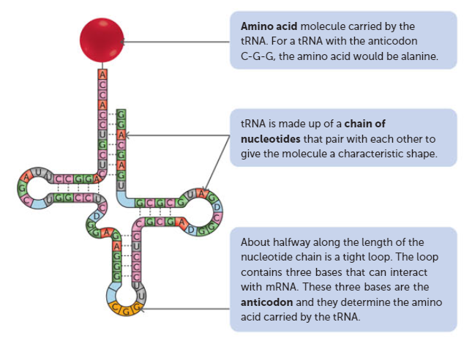

Slide 34
Translation
The amino acids carried by the tRNA are joined so that the protein is assembled with the amino acids in the correct sequence.
For each bond formed between the amino acids, the energy from the breakdown of one ATP molecule is required.
Once the tRNA has delivered its amino acid, it detaches from the ribosome and can then pick up another amino acid from the cytosol.

Slide 35
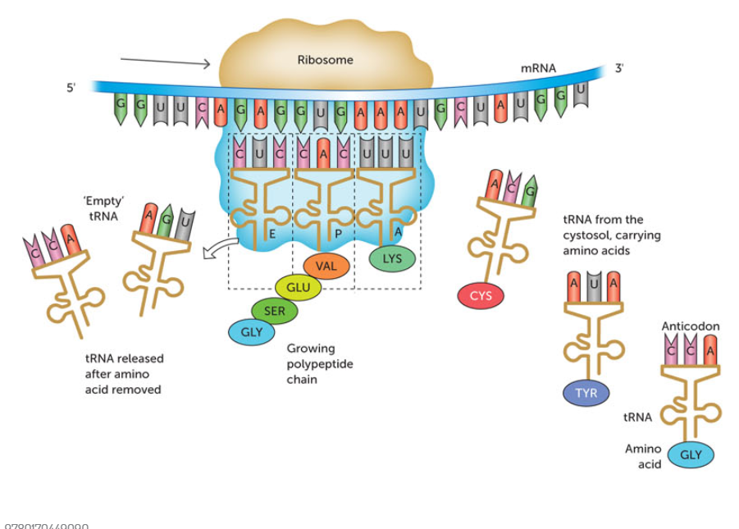

Slide 36
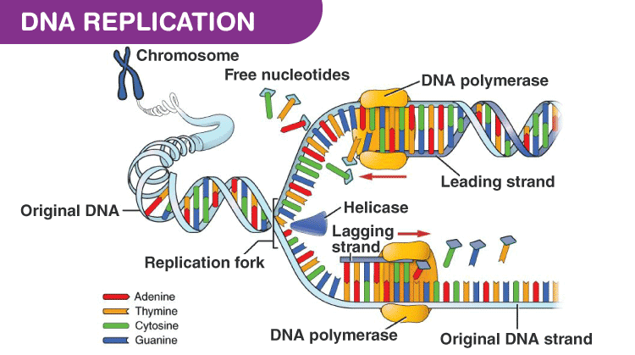

Slide 37
Key Concept
The bases sequence on the DNA is transcribed to a molecule of messenger RNA that is able to leave the nucleus.
The mRNA binds to a ribosome, where it is translated by molecules of transfer RNA adding the appropriate amino acids to form the protein.

Slide 38
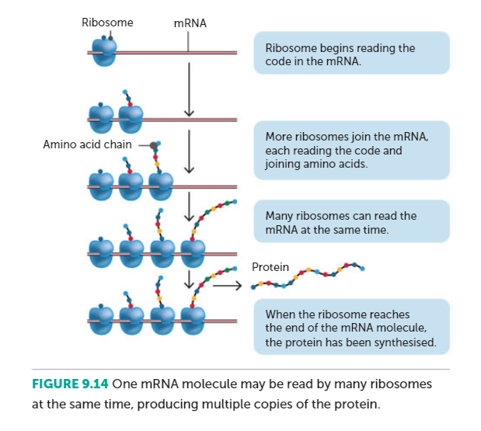

Slide 39
Gene Expression
The process of copying information from DNA on to mRNA and then translating the message into a series of amino acids to form a protein is called gene expression.
The genes contain the instructions from making mRNA, but at any given time a cell is making mRNA from only a fraction of its genes.
Genes that are being used to make mRNA are said to be ‘switched on’; a gene not being used to make mRNA is ‘switched off’.

Slide 40
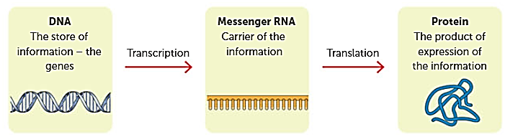

Slide 41
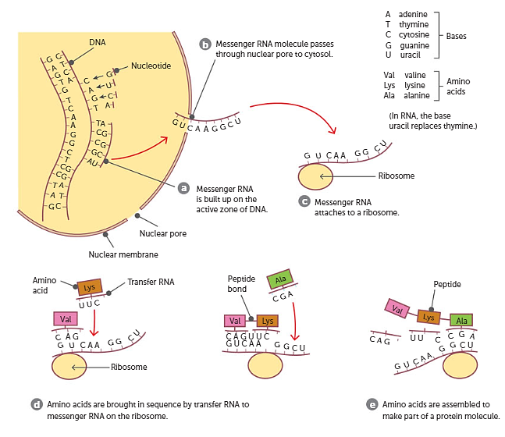

Slide 42
Lipid and Carbohydrate Synthesis
There are no genes that carry instructions for the manufacture of lipids or carbohydrates. However, the synthesis of these substances requires enzymes, and enzymes are proteins.
Genes control the synthesis of lipids and carbohydrates.

Slide 43
Types of Nucleic Acids- review
DNA | Very large molecule made of two strands of nucleotides that are joined by bonds between the nucleotide bases. The two strands are twisted into a double helix. Found in the nucleus and mitochondria of cells.
nDNA (nuclear DNA) | DNA found in the nucleus of cells
mtDNA (mitochondrial DNA) | DNA found in the mitochondria
RNA | Large molecules composed of a single strand of nucleotides
mRNA (messenger RNA) | RNA molecule that carries the code for protein synthesis from the DNA in the nucleus to the ribosome where the protein is made.
tRNA (transfer RNA) | A small RNA molecule that transfers the correct amino acid to the ribosome for inclusion in the protein molecule being made.

Slide 44
Epigenetics
The factors that make genes more or less likely to be expressed may be inherited. Scientists who work in the field of epigenetics are trying to find out the factors that help make us who we are and influence what diseases we might acquire.
There is a growing list of environmental factors that can cause epigenetic changes that are inherited by offspring, not just genetic factors.
Your epigenome is the sum of all the factors that determine when, where and which genes are ‘switched on’ or expressed. One way in which genes are regulated epigenetically is through changes in chromatin.

Slide 45
Chromatin
DNA molecules are in the form of long strands. Their length in a human cell is estimated to be between 2 and 3 metres. For 2-3 metres to fit inside the nucleus off a cell the DNA has to be TIGHTLY coiled.
The DNA molecules are coiled around special proteins called histones. The DNA and the histone proteins associated with it are called chromatin.

Slide 46
Chromatin
Gene expression may change if the way in which the DNA is wrapped around the histone changes. There are a number of ways in which a change can occur
If some of the amino acids that are in the histone proteins are changed, this will change the shape of the histone (which will in turn be copied each time a new DNA molecule is formed)
Acetylation: the addition of a acetyl group to the histone protein. This reduced the attraction between histones and DNA, relaxing the structure of the chromatin.
DNA methylation: adding methyl groups to the DNA molecule or histone proteins. This occurs at sites known as CpG sites inhibiting gene expression by restricting access to RNA polymerase.

Slide 47
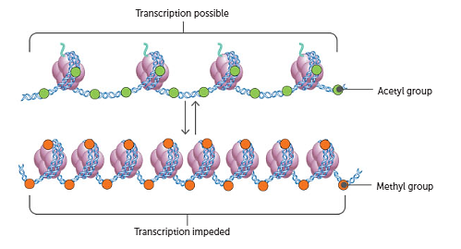
Histone methylation may increase or decrease the transcription of genes, depending on where the methyl groups attach and how man become attached. If the methylation causes the chromatin structure to relax, it will increase transcription.

Slide 48
Environment and Epigenome
A person’s epigenome can be changed by exposure to certain environmental stimuli.
Examples of environmental agents that can cause epigenetic changes are severe stress, nutritional factors, and toxins or drugs that may enter cells.
Such agents do not change the DNA, but interfere with the transcription and translation processes involved in protein production.

Slide 49
Recall Knowledge
Draw a labelled diagram of a nucleotide
Describe the structure of chromatin and chromosomes
Name the enzyme that:
Separates the strands of DNA
Transcribes the bases on the DNA molecule to produce mRNA
Describe the role of anticodons in the process of protein synthesis

Slide 50
Apply Knowledge
State two similarities and two differences between nuclear DNA and mtDNA
Explain why messenger RNA is needed for protein synthesis
Explain why identical twins are used when studying epigenetics.
Compare and contrast acetylation and methylation

Slide 51
Homework
Explain how a person’s genome is different from their epigenome.

Slide 52
Reading
Pages 230 - 241: DNA determines the structure and function of cells.

